Slide 1
Salary Data
Presentation Practice Layout & Info
(capstone will be in a different environment)

Slide 2
So…. what about it?
In the American job market, income disparities exist based on different factors. As job applicants, we want to know how much jobs pay us, what industry would benefit us, how much time we would need to get to a higher level role, etc.
Data analysis can help us determine where in the job market that we would benefit from or be at a disadvantage when it comes to numerical data like salary.

Slide 3
Questions You Might Have
What gender makes more money on average?
What industry does the manager makes the least amount of money?
How much does the salary vary depending on education levels?
What is the relationship between industry experience vs salary?
We will be exploring this data with these questions in mind.
*I would normally include another slide to dictate a short explanation of what the dataset looked at and what I did to clean the data/prep it.

Slide 4
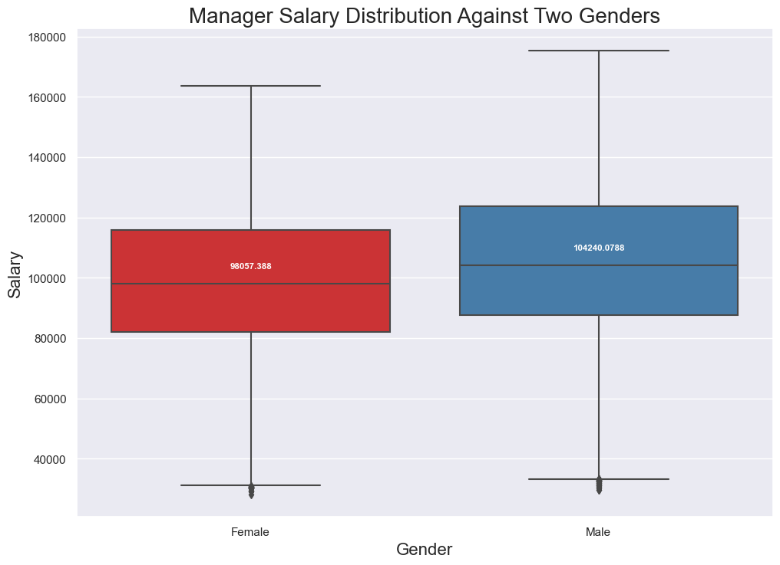
Female:
12730 values
Min = $28,054.08
Max = $163,708.41
Median = $98,057.39
Male:
12709 values
Min = $29,725.18
Max = $175,223.32
Median = $104,240.08
All across the board, men average higher than women based on the total number of data values we have.

Slide 5
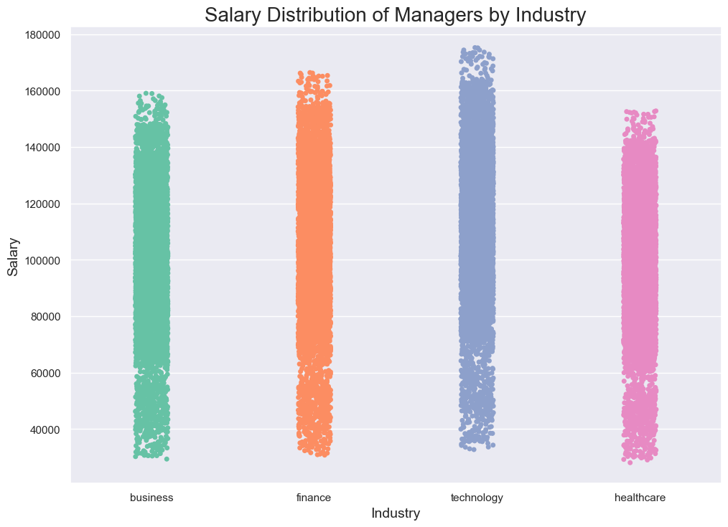
Business:
Median: $98200.01
Range: $29,340.68 - $159,030.78
Finance:
Median: $102,692.36
Range: $30,747,52 - $166,370.22
Technology:
Median: $109,130.18
Range: $32,704.34 - $175,223.32
Healthcare:
Median: $94,728.96
Range: $28,054.08 - $152,775.99

Slide 6
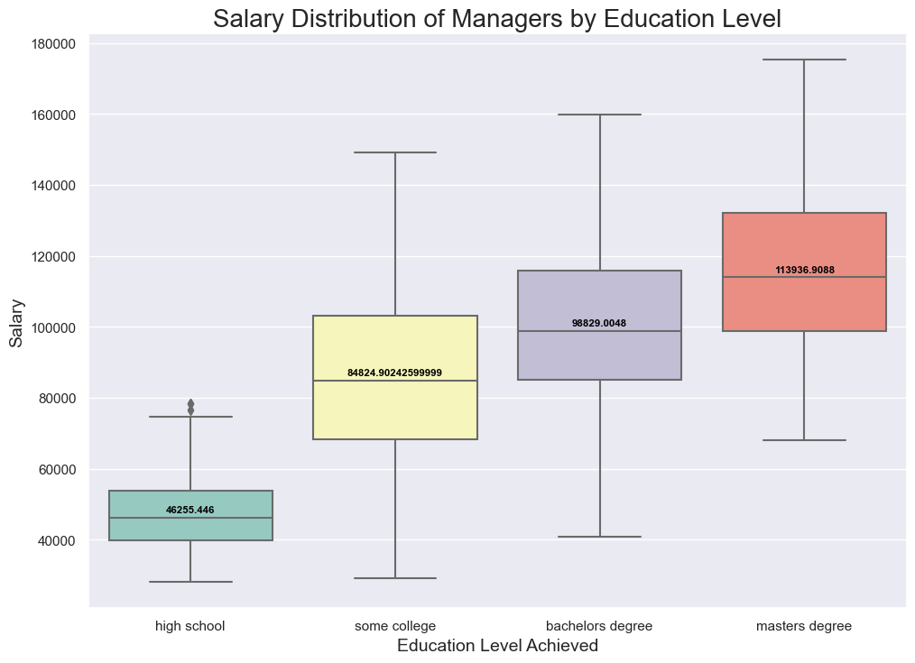
Here I would speak about the salary variance in each education level.

Slide 7
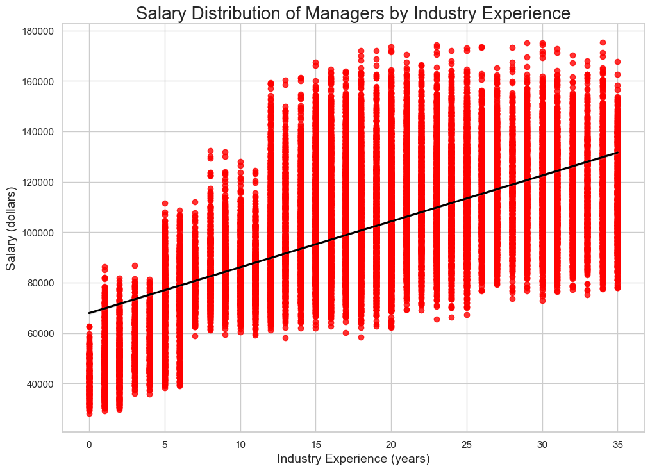
Emphasize the RELATIONSHIP between the variables here.

Slide 8
Caveats?
(summary stats)
(significance)
(downfalls)

Slide 9
Review… what did we observe?
Lead the audience to make their own observations.
Answers questions.
Females made less
Health sucked, tech made a lot
Older more money usually
More exp better salary in every industry

